Slide 1


ME 370
Package Dispensing Legged Robot
(Team 48: Sebastian Missong, Daniel Koltchev,Shihong Yuan, Liangbing Zhao)
10/24/2025

Slide 2

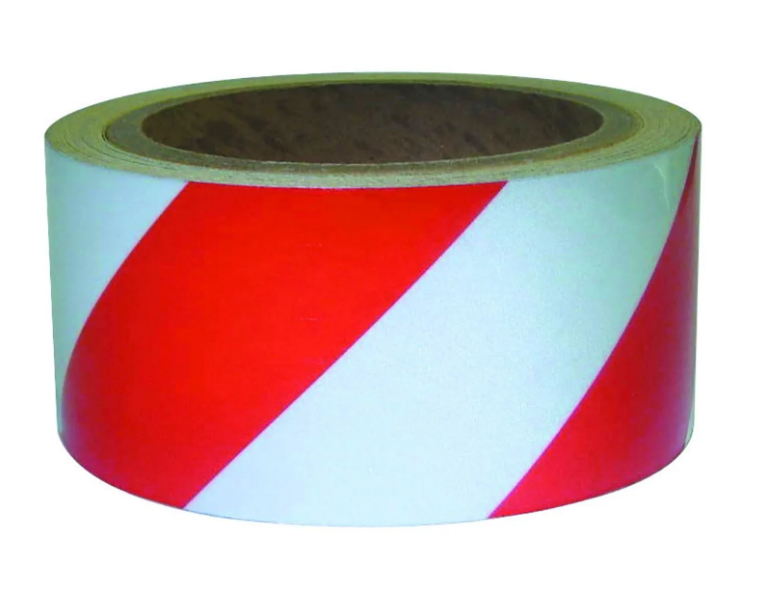
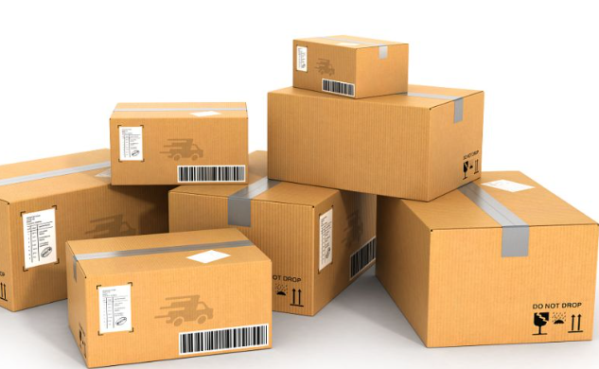
Desired Outcomes For Dispensing Robot
Theme Considerations:
Visibility
  Easy to distinguish in operating environment
  Remove risk of collision with people
Compatibility
a. Deliver packages of different sizes
Technical Considerations:
Low center of mass for balance and no rollover.
Place the package every 2 meters. High accuracy.
Pushing down the package quickly not cause any lag. Gear ratio and partial gear
Mechanical Science and Engineering
Daniel Koltchev
GRAINGER ENGINEERING

Slide 3
Desired Outcomes For Dispensing Robot
Dispensing
Robustness
  Crank, pusher, and pushrod link must be able to handle the weight of the 5 packages and still operate smoothly
Compactness
  The majority of the robot volume should be for the packages, not the mechanisms to dispense them
    Purpose of the robot
Quick Operation
  Dispensing packages quickly at drop-off intervals
  Not slowly pushing the package and it falling off by itself after certain distance
Mechanical Science and Engineering
Daniel Koltchev
GRAINGER ENGINEERING

Slide 4
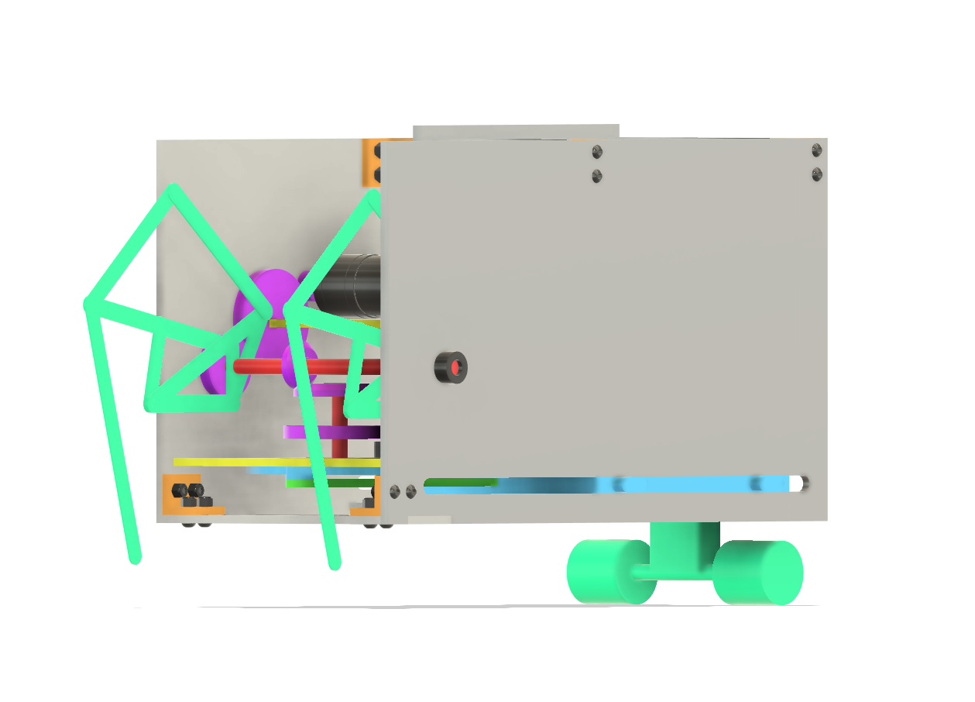
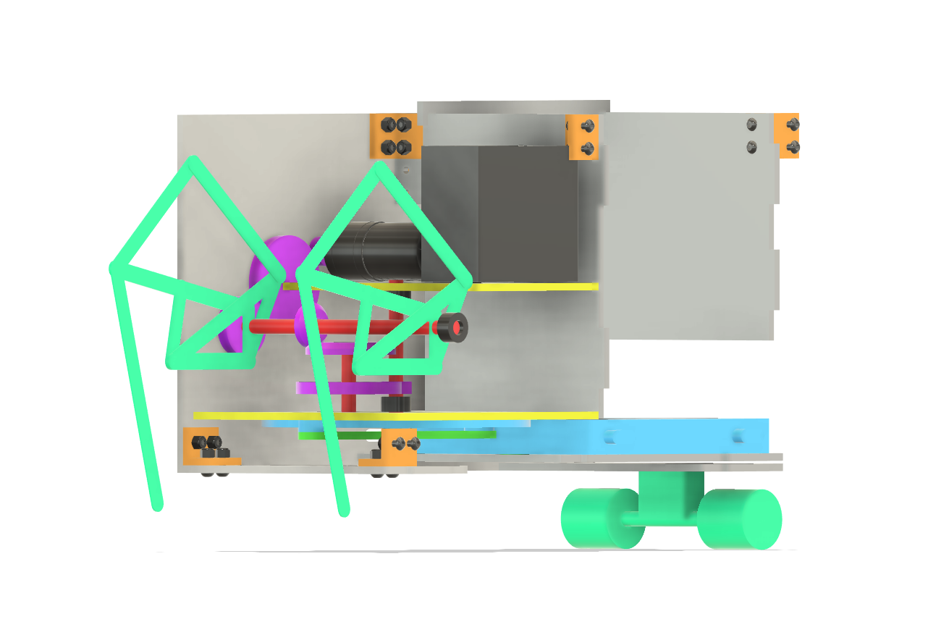
Idea 1
Overview
Move crank for dispensing mechanism to be horizontal -> create more space for legs motion and drivetrain
Use partial gear on crank to allow for dispensing every 2 m
  Less often then leg movement but movement needs to be quick
Two passive wheels and two legs
  Klann linkage
  Legs out of phase so always 3 points of contact
Isometric View of Complete Walker
Isometric View of Walker with One Wall Removed
Sebastian
Mechanical Science and Engineering
GRAINGER ENGINEERING

Slide 5
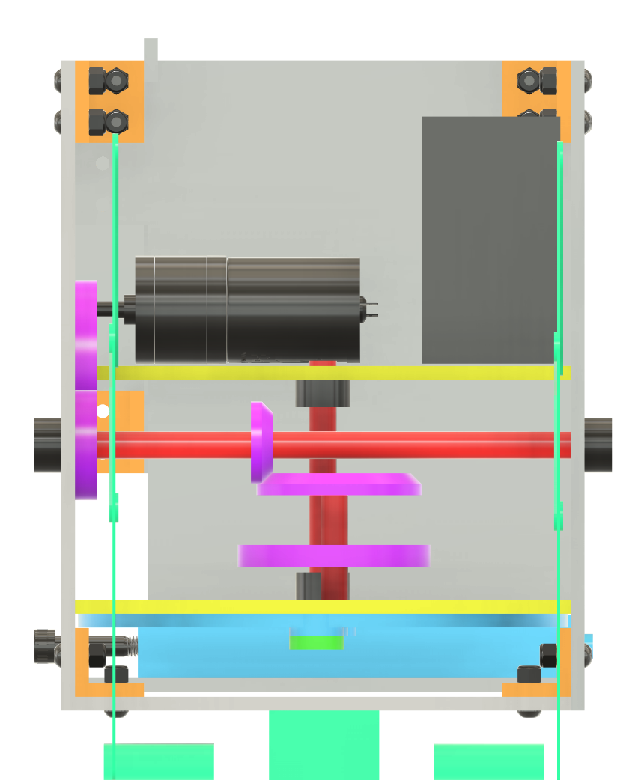
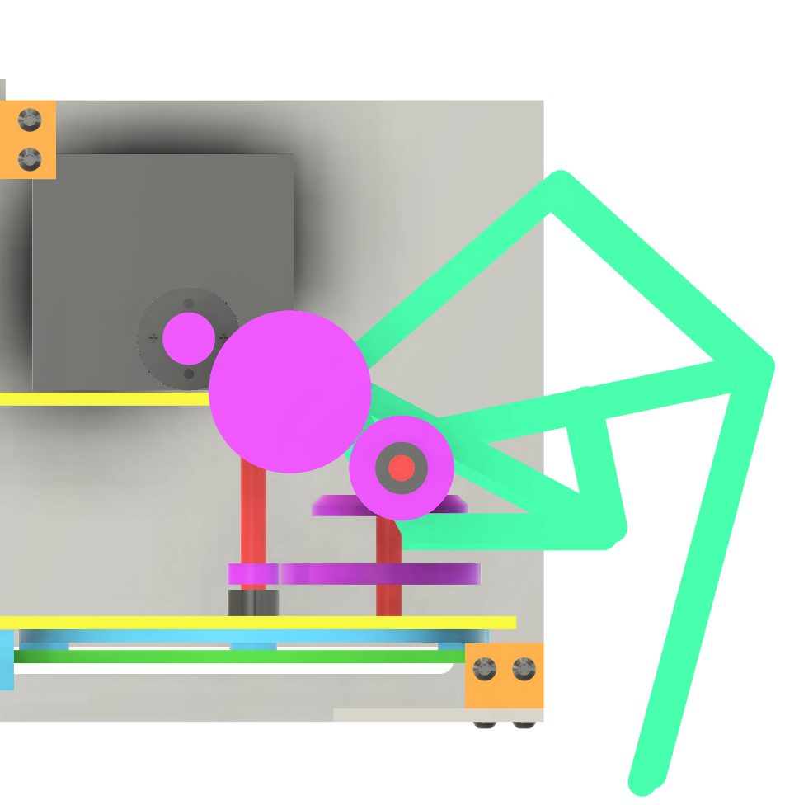
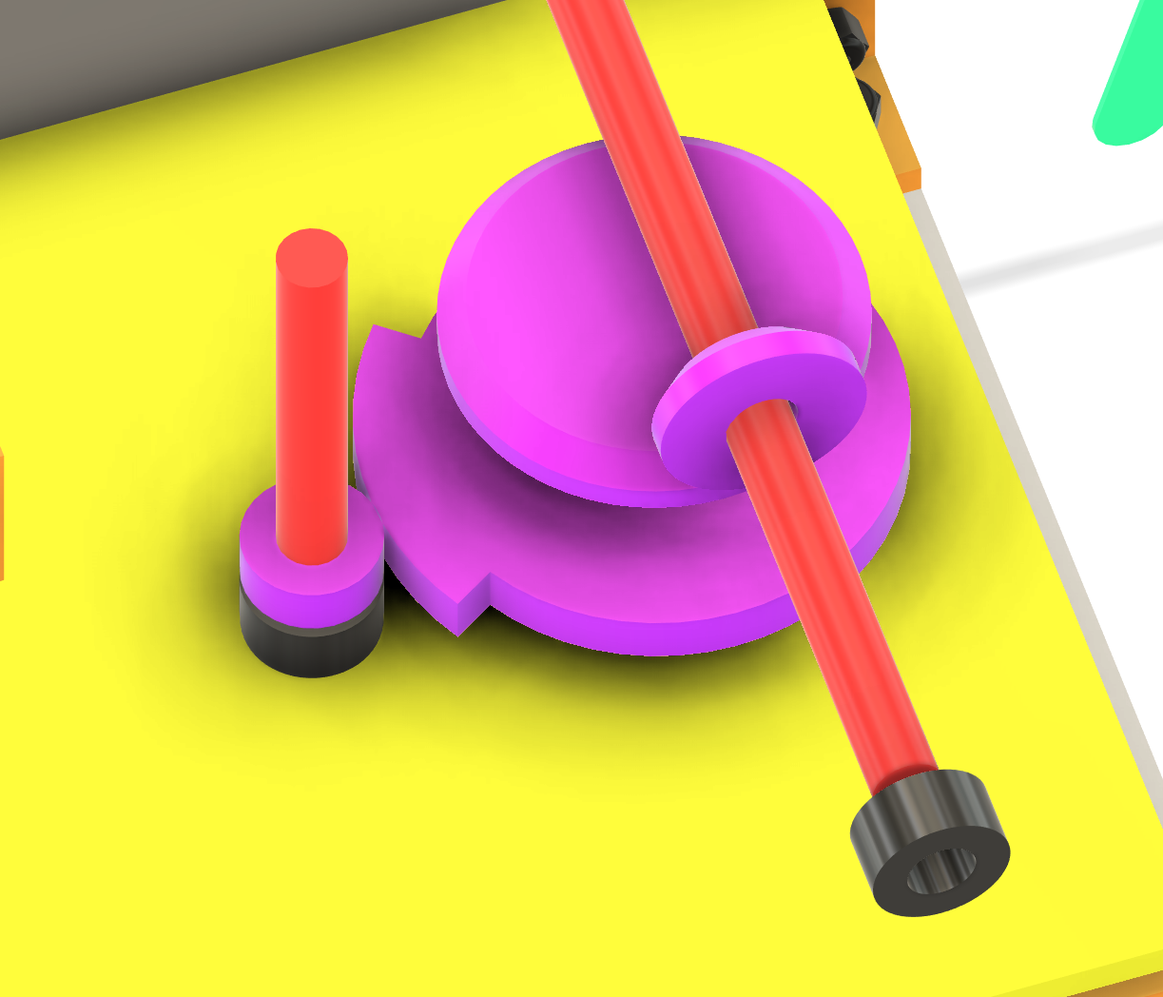
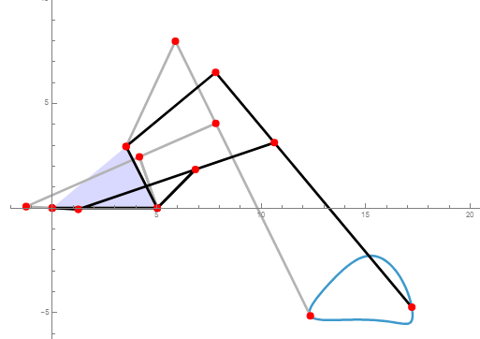
Idea 1
Drivetrain
Gears connecting motor to leg driveshaft for legs
Bevel gear reduction off of leg driveshaft to partial gear
Partial gear connects to much smaller gear on crank
  Crank gear must be small enough so all of partial gear motion corresponds to 1 full crank rotation
Shaft collars used to constrain driveshafts
Front View
Path
Side View
Detailed View of Partial Gear
Sebastian
Mechanical Science and Engineering
GRAINGER ENGINEERING

Slide 6
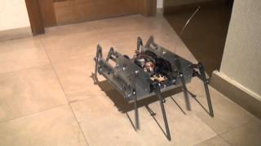
Idea 1
Walking Mechanics
Stability
  Ensure that packages stay stable
    Instability can disturb operation of dispensing mechanism
Smooth Motion
  Klann linkage
Mechanical Science and Engineering
Daniel Koltchev
GRAINGER ENGINEERING

Slide 7
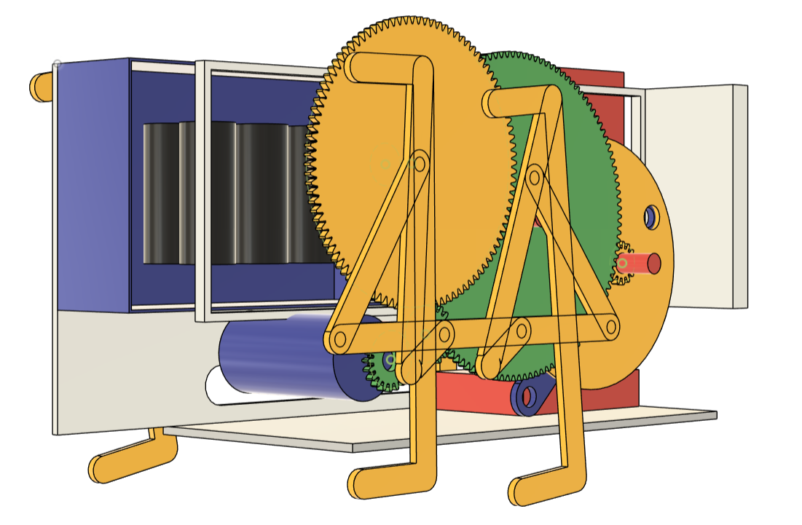
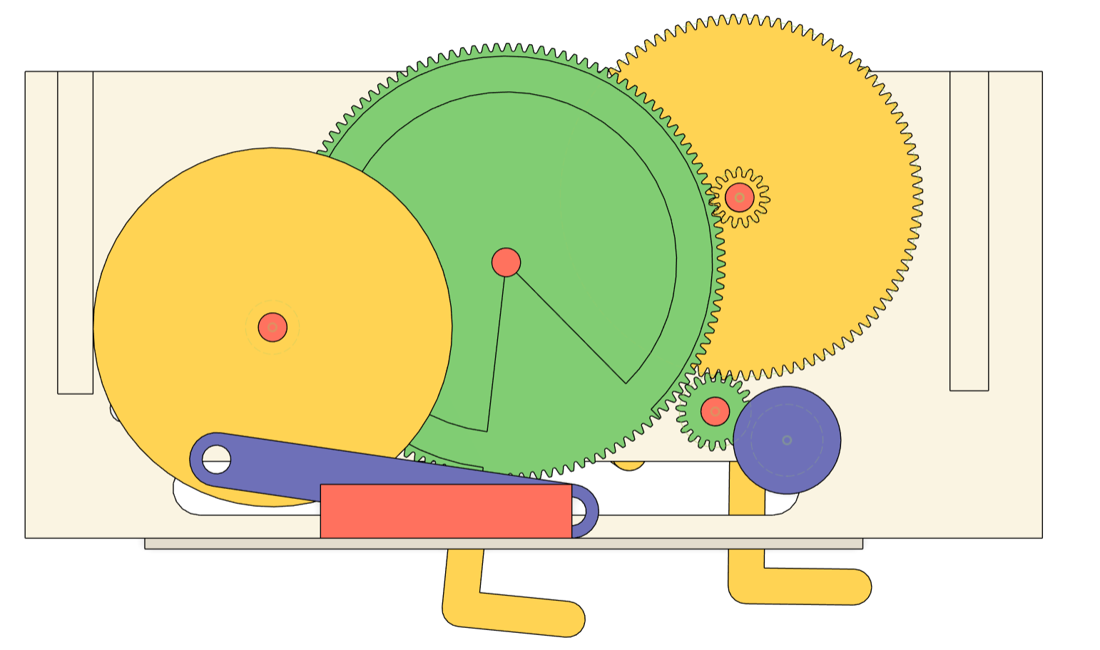
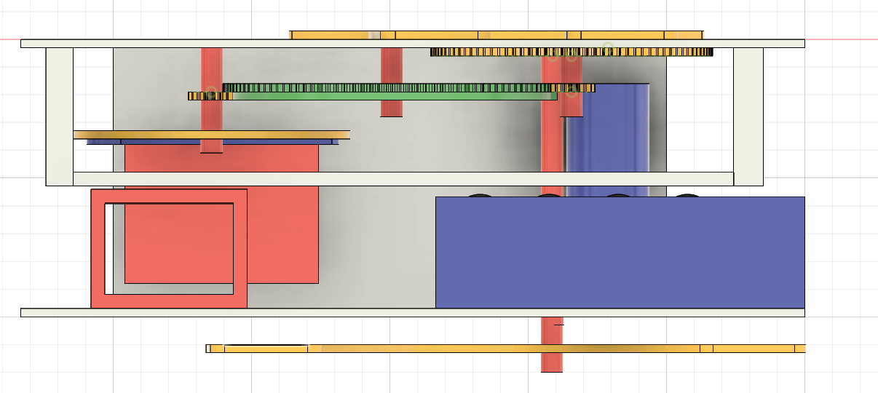
Idea 2
Overview
Drivetrain Mechanism (why not 1:39 but 5:35 )
  Partial geer transmission
  Total Cycle: 40 rotations of the leg gear.
  Phase 1 (5 rotations): Dispenser is engaged, completing one full action.
  Phase 2 (35 rotations): Dispenser idles.
Leg Mechanism (Balance)
  Chebyshev's plantigrade machine
Placement (Top View)
  Top Half: Drivetrain & Motor
  Bottom Left: Dispensing Mechanism
  Bottom Right: Battery Box
Isometric View of Complete Walker
top view
side view-detailed view of the drivetrain
Shihong Yuan
Mechanical Science and Engineering
GRAINGER ENGINEERING

Slide 8
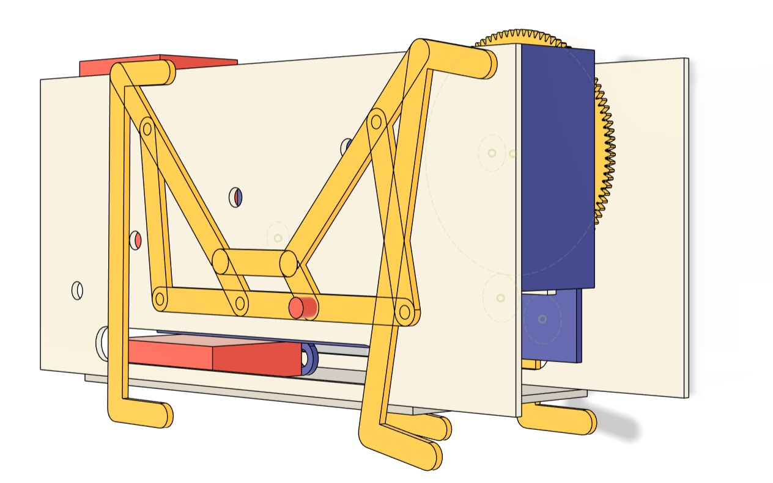

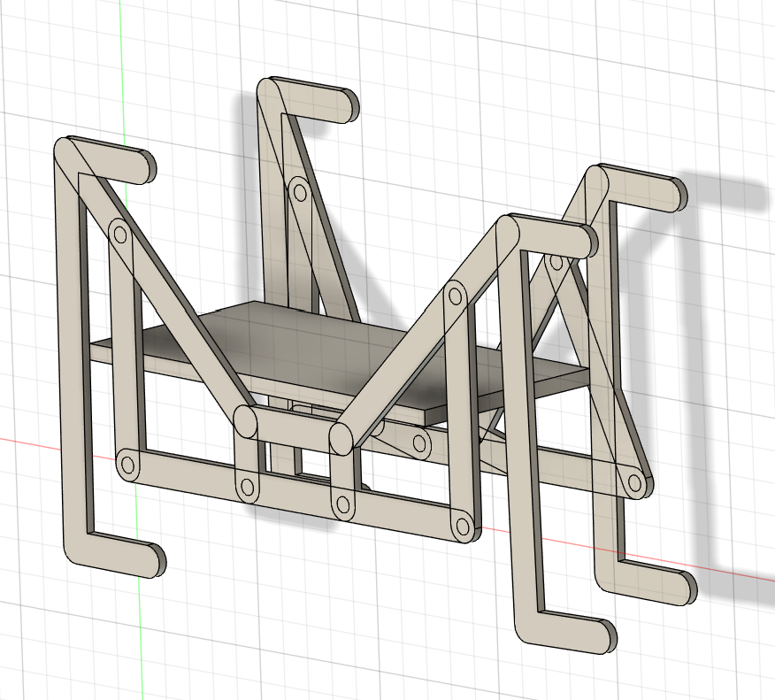
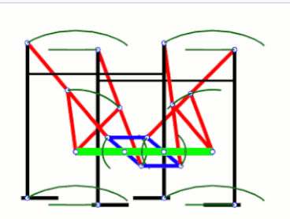
Idea 2
Leg mechanism (Chebyshev's plantigrade machine)
Grouping: Legs are coordinated in diagonal pairs (e.g., Left-Front/Right-Rear).
Coordination: Pairs are driven 180° out-of-phase.
Gait : While one diagonal pair is in the Stance Phase (propelling on ground), the other is in the Swing Phase (lifted and advancing).
Stability: The walker always maintains two diagonal support points, keeping the center of mass stable.
Side view of the leg mechanism
Path
A detailed view of the legs
Shihong Yuan
Mechanical Science and Engineering
GRAINGER ENGINEERING

Slide 9
Compare and contrast of ideas
Idea 1:
Two passive wheels and two legs always in contact with ground, stable.
Requires bevel gears, a more complex drivetrain structure.
Occupies a large internal space, limited space for packages.
Idea 2 :
Two feet on the ground when walking, unstable.
Only install drivetrain structure on one side, simpler in structure. More space for packages.
Too large gear may exceeds the specified height.
We will choose to use the Idea1 leg structure design because it is more stable,
considers using fewer transmission structures like Idea 2,
avoids exceeding the specified size, and leaves enough space for placing packages.
Liangbing Zhao
Mechanical Science and Engineering
GRAINGER ENGINEERING

Slide 10
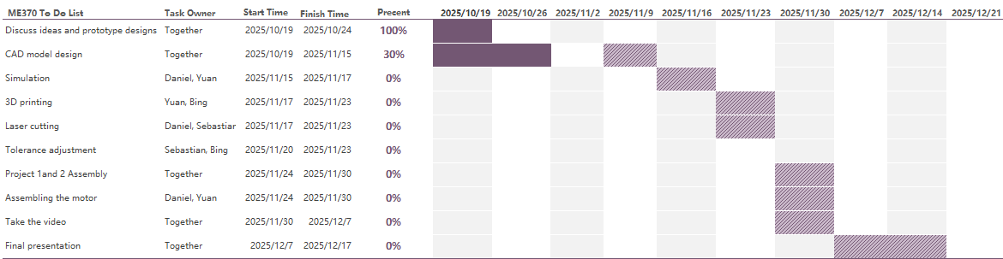
Future plans
New Dispenser
Test Dispenser
Test Both
P2D2
Walking Parts
Test Walking
Revise Both
Liangbing Zhao
Mechanical Science and Engineering
GRAINGER ENGINEERING

Slide 11


